Slide 1
CoPilot Safe Assist
Software Engineering 2: Project Teamwork Mälardalen University
Optimus Octavian
Steering Group Meeting Nr.5

Slide 2
Last week

Slide 3
Last week’s plan
Deliverables √
Client and MDH contact meeting √
Software architecture √
Detailed system design √
Android and Web mock-ups √
Notification Testing (ongoing)
Front-end √ (not planned)
Notes:
Deliverables = prototype + design description
Client meeting = get the device

Slide 4
1- Online meeting with the client
Presentation of the actual work progress and ideas
Satisfied client
Schedule next meeting
Added suggestions in the features
Requested to put all ideas in the backlog (not only the implementable ones) as future reference
Danger Zone – no specific answer from client, up to testing!
Client and MDH contact meeting √

Slide 5
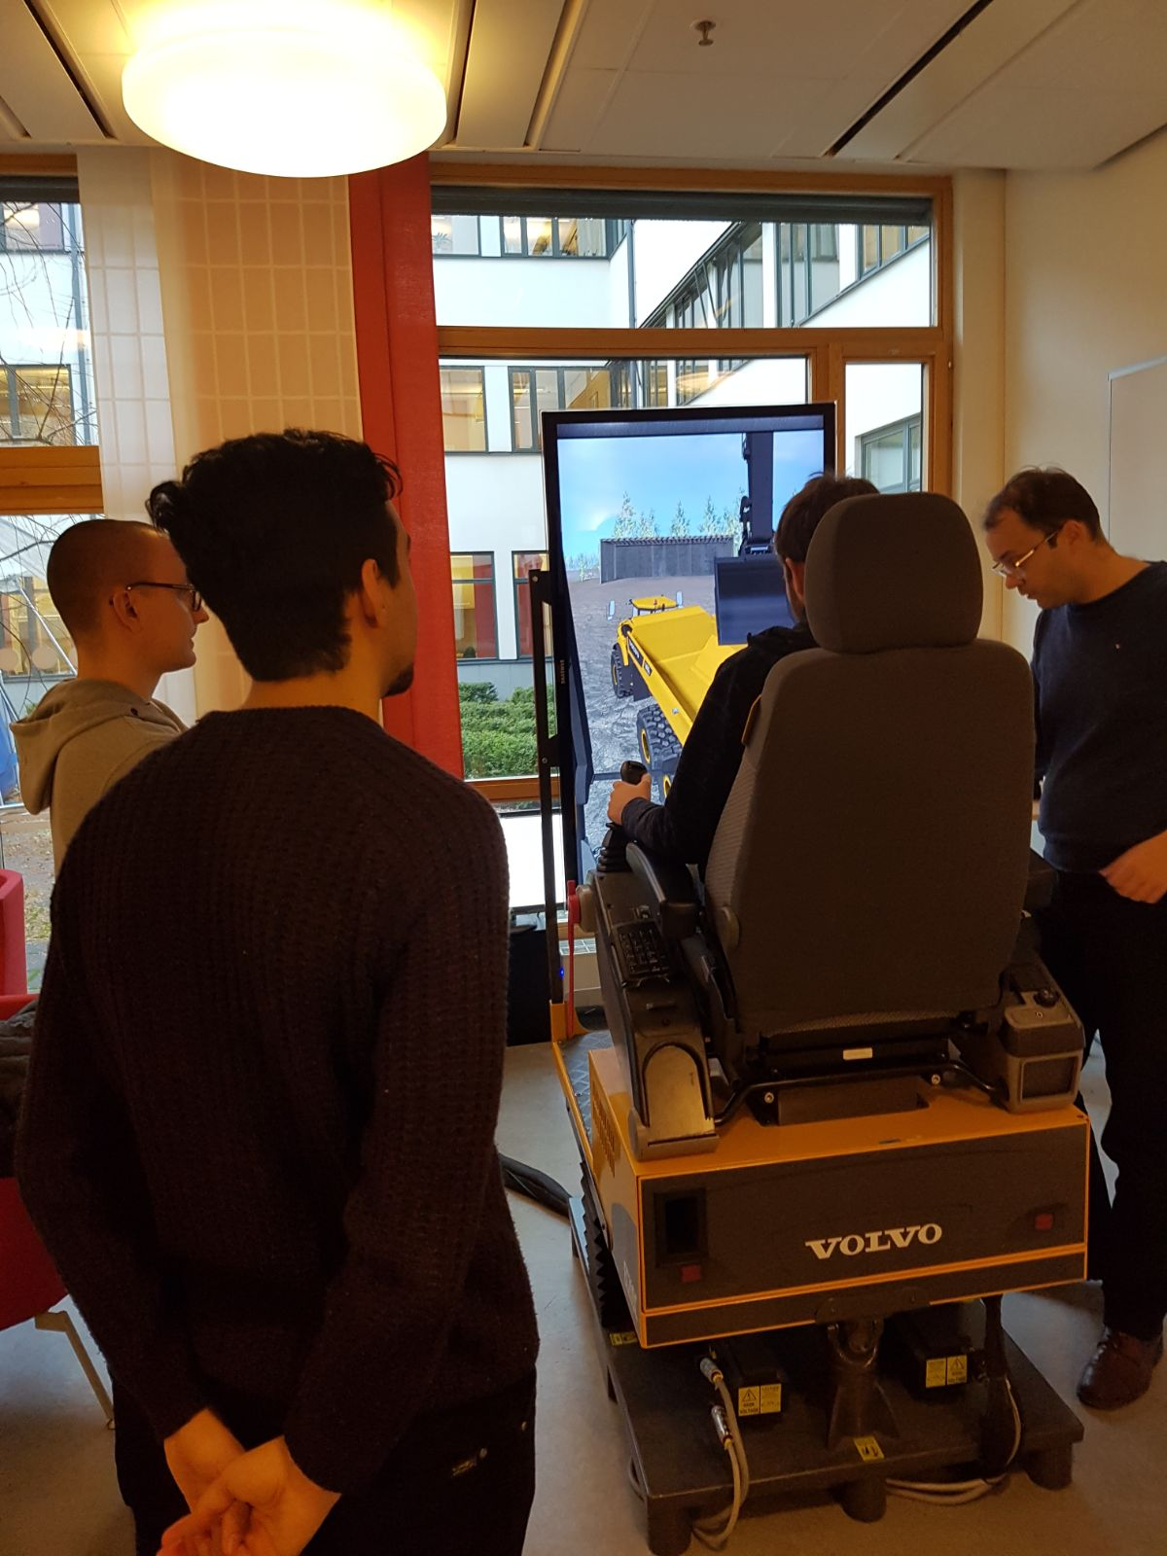
2- Meeting with MDH Contact
Showing and testing of the simulator with the CoPilot device
Technical information on the CoPilot
Client and MDH contact meeting √

Slide 6
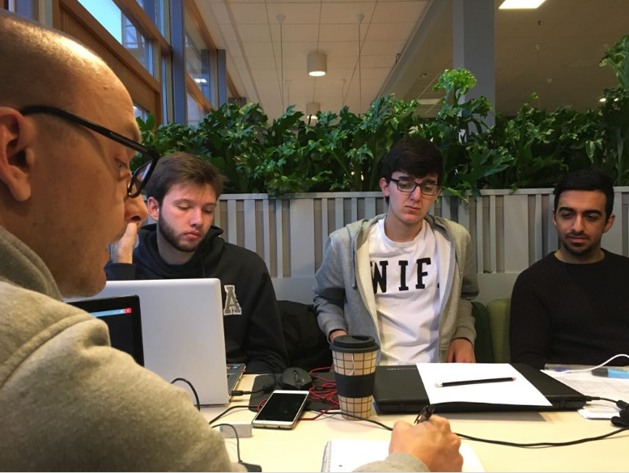
3- Group Meeting (Tuesday)
Decided on the Software Architecture
Decided on the Implementation Details
Software architecture √ Detailed system design √

Slide 7
4- Group Meeting (Wednesday)
Review of Design Description
Working on the final details
Deliverables √ Android and Web mock-ups √

Slide 8
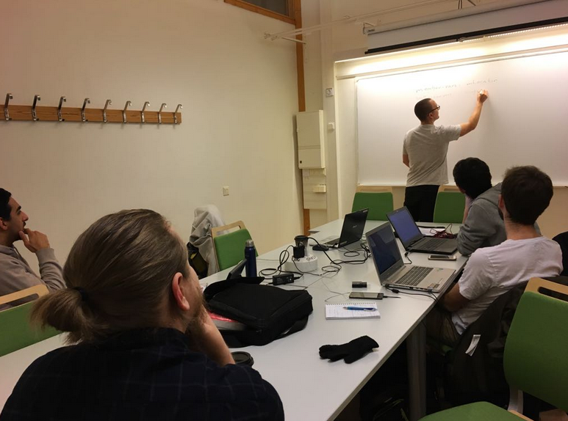
5- Group Meeting (Friday)
Decided on the work plan of the following week
Decided on the members who would participate in the 2nd mandatory presentation
Update Trello board

Slide 9
Worked hours
Members | Worked Hours this week | Total of Worked Hours
Alvaro | 0 (Lapland Trip) | 42
Dara | 14.5 | 67
Fernando | 15.5 | 71
Jonas | 20.5 | 63
Pablo | 16.5 | 60
Rickard | 19 | 77
Sidorela | 34.5 | 75
Vasja | 19 | 63
PS. Some members still need to update their worked hours!!

Slide 10
This week

Slide 11
This week’s plan
Implementation (backend)
Application (classes and functionalities)
Web Page
CoPilot device communication
Design description presentation
Notes:
Deliverables = prototype + design description
Client meeting = get the device

Slide 12
Demo Video

Slide 13
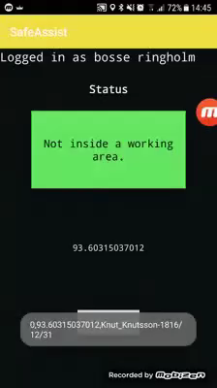

Slide 14
Thank you!
Questions?

